Slide 1
Ask VA (AVA)
How to establish an account

Slide 2
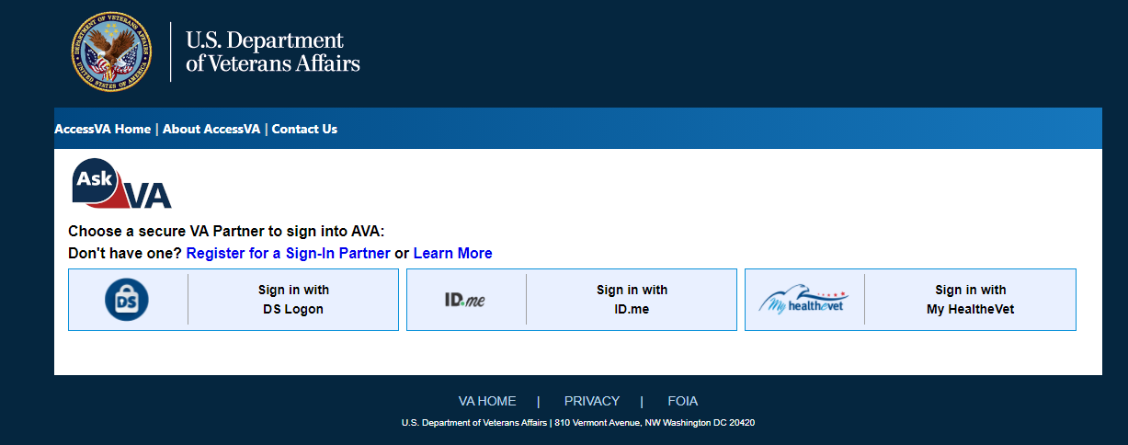
Go to https://ask.va.gov/
Click on the ID.me tab

Slide 3
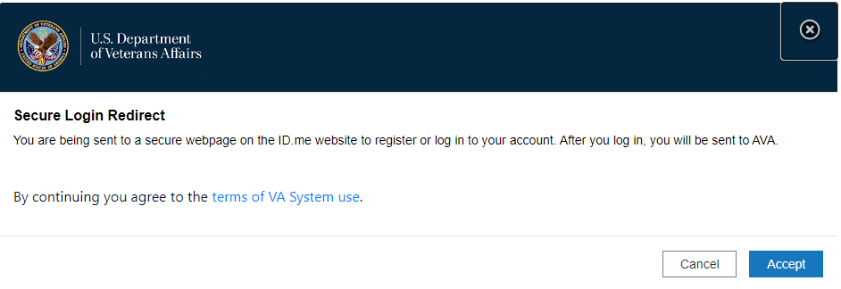
That will lead you to. Accept the Terms

Slide 4
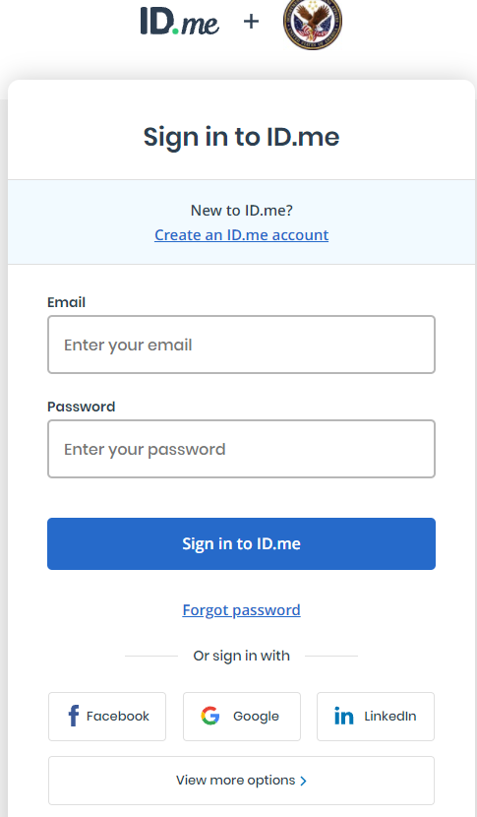
Which will then direct you to this site, you’ll need to click on “Create an ID.me account”

Slide 5
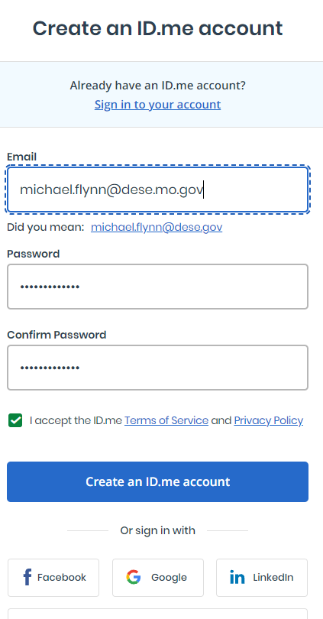
Enter your email, create a password and confirm it, accept the terms and the click the “Create an ID.me account”.

Slide 6
Once you’ve done that you’ll go to a page where it asks you to confirm your identity. You can do that a number of ways,
Two forms of photo id such as passport and driver’s license
Provide social security number and then answer questions they’ll ask about your credit, what type of vehicle you have, etc.
I think there are other methods including a virtual, in-person method.

Slide 7
Once you have your id.me account then go to https://ask.va.gov/
Click on the id.me tab

Slide 8
Which will then direct you to this site.
Sign in using your email and password that you just created.

Slide 9
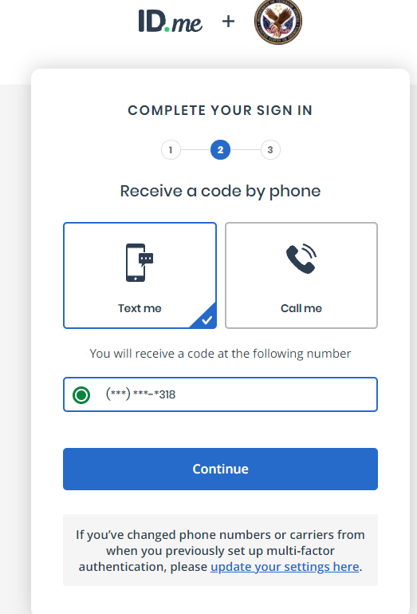
You will be directed to this page.
Select a text or a call so you can confirm who you are.

Slide 10
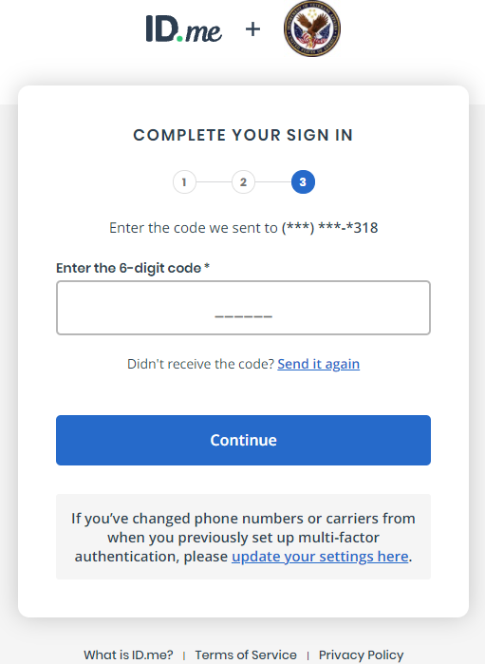
Enter the code you are given.

Slide 11
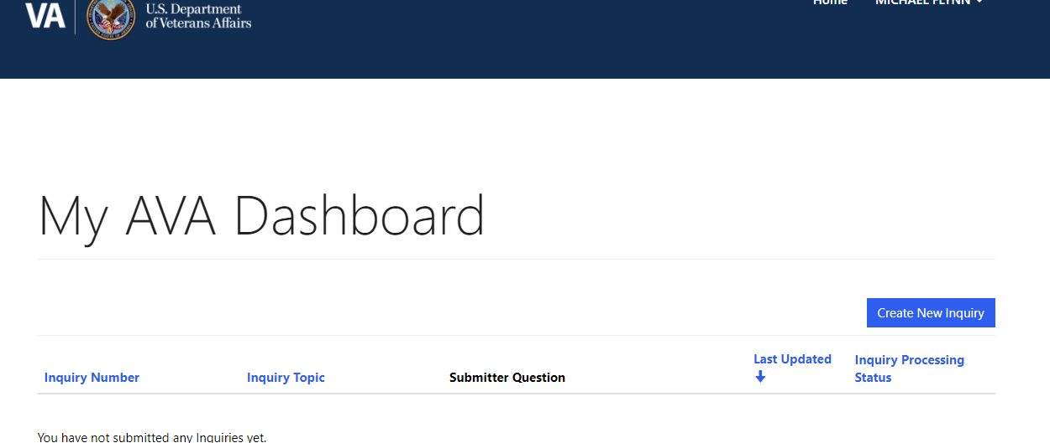
You will be directed back to the ASK VA website.
Click the “Create New Inquiry” to submit your forms.

Slide 12
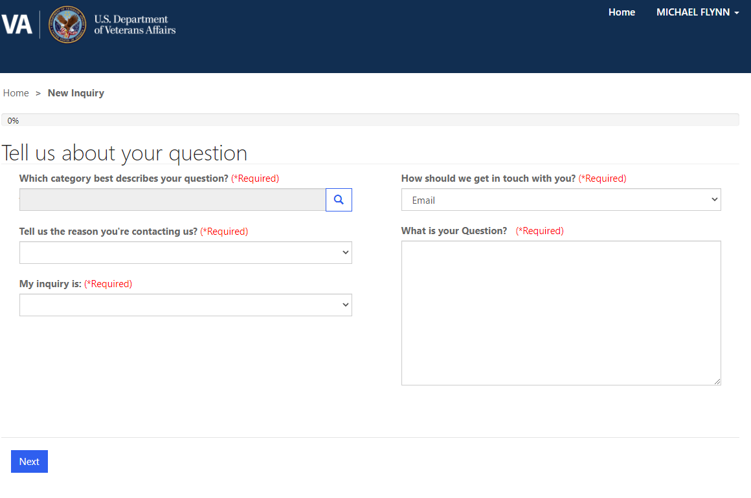
You will be brought to this screen.
When you click the magnifying glass your get categories and the first one is “GI Biill”
Under the reason tab there is a category marked “School Officials ONLY” on the second page.
Once you click that you’ll get options to enter the information and your facility code.

